Slide 1


Lecture 16
Produced by Dr. Worldwide
Welcome to the 305
~
~

Slide 2

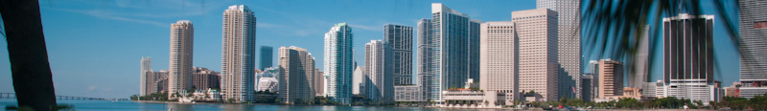
Excel for Goal Programming
Builds off linear programming using Excel Solver
Solve the linear program multiple times with different objective functions
Go in order of priority
After finding the optimal solution, we add the optimal value attained in the first objective function as a new constraint and move on to the next objective function
Possible that while solving for a given priority, we simultaneously optimize other lower ranked priorities

Slide 3
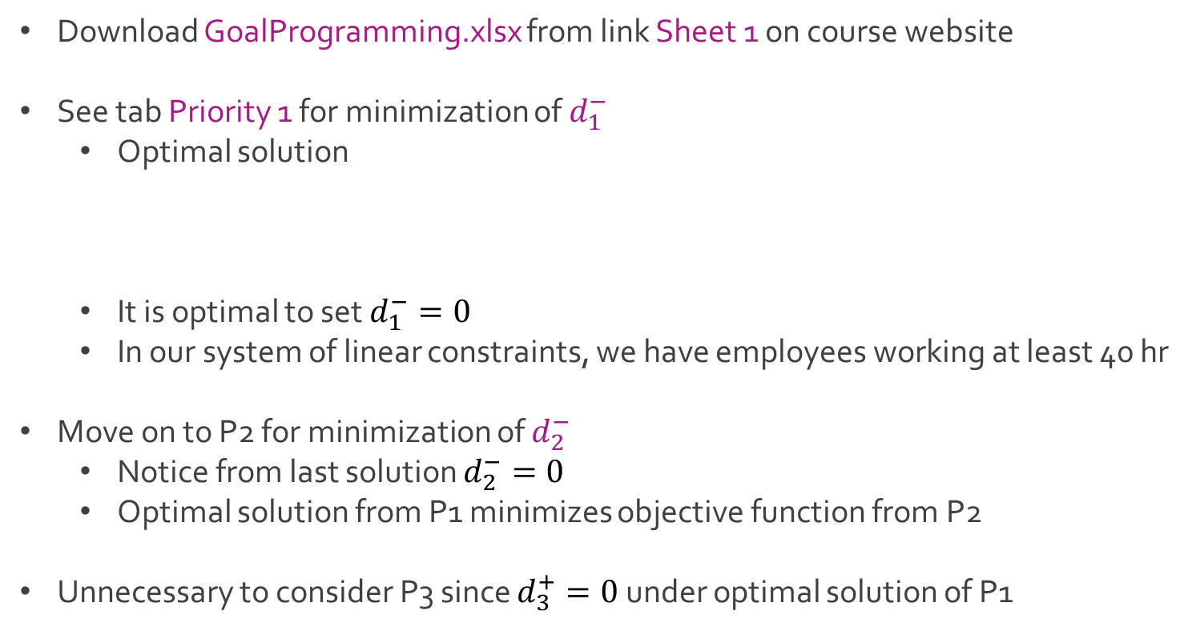
Ex: Beaver Creek Pottery
Download GoalProgramming.xlsx from link Sheet 1 on course website
See tab Priority 1 for minimization of $d_{1}^{−}$
Optimal solution
It is optimal to set $d_{1}^{−}=0$
In our system of linear constraints, we have employees working at least 40 hr
Move on to P2 for minimization of $d_{2}^{−}$
Notice from last solution $d_{2}^{−}=0$
Optimal solution from P1 minimizes objective function from P2
Unnecessary to consider P3 since $d_{3}^{+}=0$ under optimal solution of P1
$x=15 y=20 d_{1}^{+}=15 d_{4}^{+}=5 d_{5}^{−}=15$
$d_{1}^{−},d_{2}^{−},d_{2}^{+},d_{3}^{−},d_{3}^{+},d_{4}^{−},d_{6}^{−}=0$

Slide 4
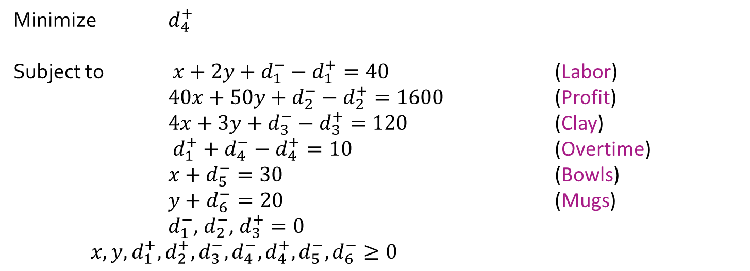
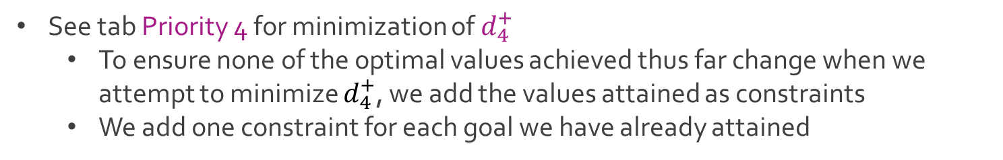
Ex: Beaver Creek Pottery
See tab Priority 4 for minimization of $d_{4}^{+}$
To ensure none of the optimal values achieved thus far change when we attempt to minimize $d_{4}^{+}$, we add the values attained as constraints
We add one constraint for each goal we have already attained
Minimize $d_{4}^{+}$
Subject to $x+2y+d_{1}^{−}−d_{1}^{+}=40$ (Labor)
$40x+50y+d_{2}^{−}−d_{2}^{+}=1600$ (Profit)
$4x+3y+d_{3}^{−}−d_{3}^{+}=120$ (Clay)
$d_{1}^{+}+d_{4}^{−}−d_{4}^{+}=10$ (Overtime)
$x+d_{5}^{−}=30$ (Bowls)
$y+d_{6}^{−}=20$ (Mugs)
$d_{1}^{−}$, $d_{2}^{−}$, $d_{3}^{+}=0$ $x,y,d_{1}^{+},d_{2}^{+},d_{3}^{−},d_{4}^{−},d_{4}^{+},d_{5}^{−},d_{6}^{−}≥0$

Slide 5
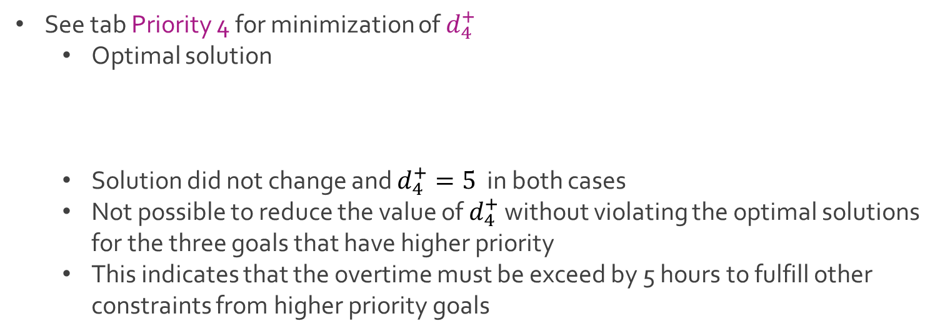
Ex: Beaver Creek Pottery
See tab Priority 4 for minimization of $d_{4}^{+}$
Optimal solution
Solution did not change and $d_{4}^{+}=5$ in both cases
Not possible to reduce the value of $d_{4}^{+}$ without violating the optimal solutions for the three goals that have higher priority
This indicates that the overtime must be exceed by 5 hours to fulfill other constraints from higher priority goals
$x=15 y=20 d_{1}^{+}=15 d_{4}^{+}=5 d_{5}^{−}=15$
$d_{1}^{−},d_{2}^{−},d_{2}^{+},d_{3}^{−},d_{3}^{+},d_{4}^{−},d_{6}^{−}=0$

Slide 6
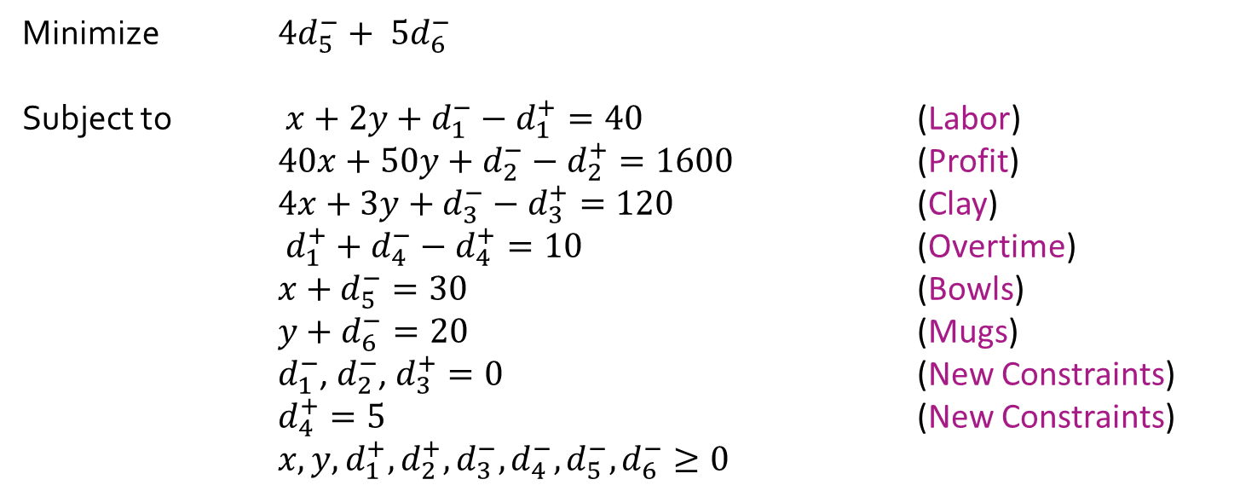
Ex: Beaver Creek Pottery
See tab Priority 5 for minimization of $4d_{5}^{−}+ 5d_{6}^{−}$
Add result from previous priority rank as a constraint
Minimize $4d_{5}^{−}+ 5d_{6}^{−}$
Subject to $x+2y+d_{1}^{−}−d_{1}^{+}=40$ (Labor)
$40x+50y+d_{2}^{−}−d_{2}^{+}=1600$ (Profit)
$4x+3y+d_{3}^{−}−d_{3}^{+}=120$ (Clay)
$d_{1}^{+}+d_{4}^{−}−d_{4}^{+}=10$ (Overtime)
$x+d_{5}^{−}=30$ (Bowls)
$y+d_{6}^{−}=20$ (Mugs)
$d_{1}^{−}$, $d_{2}^{−}$, $d_{3}^{+}=0$ (New Constraints)
$d_{4}^{+}=5$ (New Constraints) $x,y,d_{1}^{+},d_{2}^{+},d_{3}^{−}, d_{4}^{−},d_{5}^{−},d_{6}^{−}≥0$

Slide 7
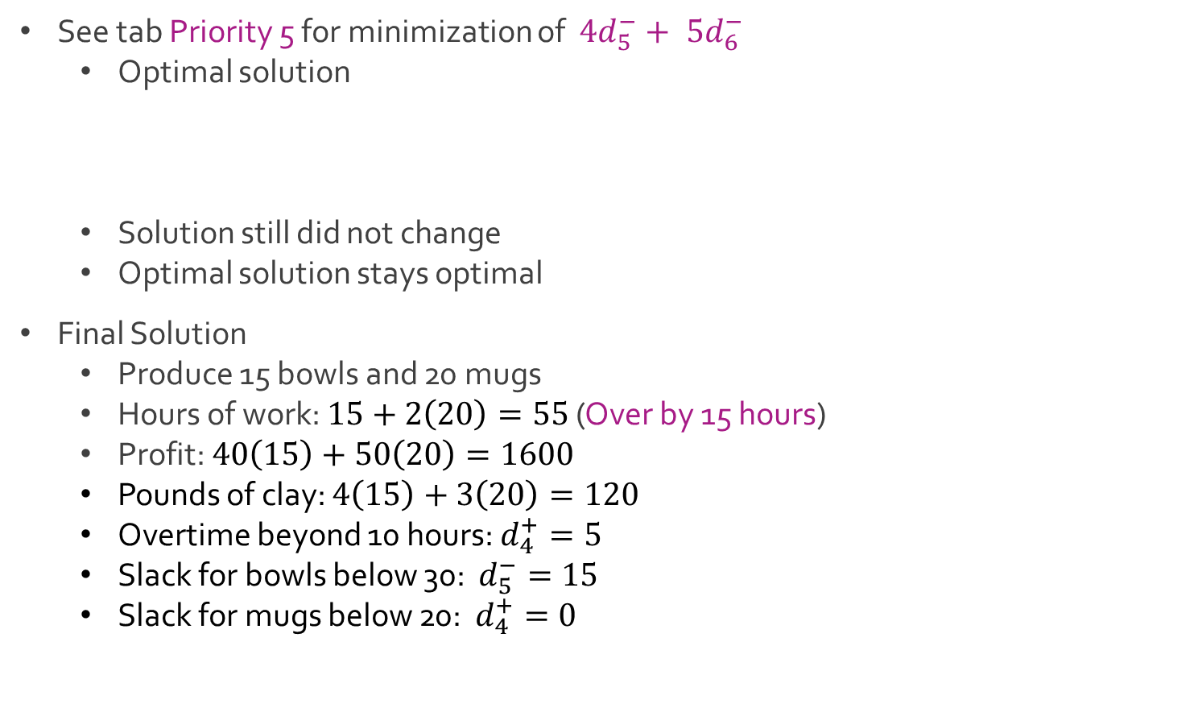
Ex: Beaver Creek Pottery
See tab Priority 5 for minimization of $4d_{5}^{−}+ 5d_{6}^{−}$
Optimal solution
Solution still did not change
Optimal solution stays optimal
Final Solution
Produce 15 bowls and 20 mugs
Hours of work: $15+2\left(20\right)=55$ (Over by 15 hours)
Profit: $40\left(15\right)+50\left(20\right)=1600$
Pounds of clay: $4\left(15\right)+3\left(20\right)=120$
Overtime beyond 10 hours: $d_{4}^{+}=5$
Slack for bowls below 30: $d_{5}^{−}=15$
Slack for mugs below 20: $d_{4}^{+}=0$
$x=15 y=20 d_{1}^{+}=15 d_{4}^{+}=5 d_{5}^{−}=15$
$d_{1}^{−},d_{2}^{−},d_{2}^{+},d_{3}^{−},d_{3}^{+},d_{4}^{−},d_{6}^{−}=0$

Slide 8
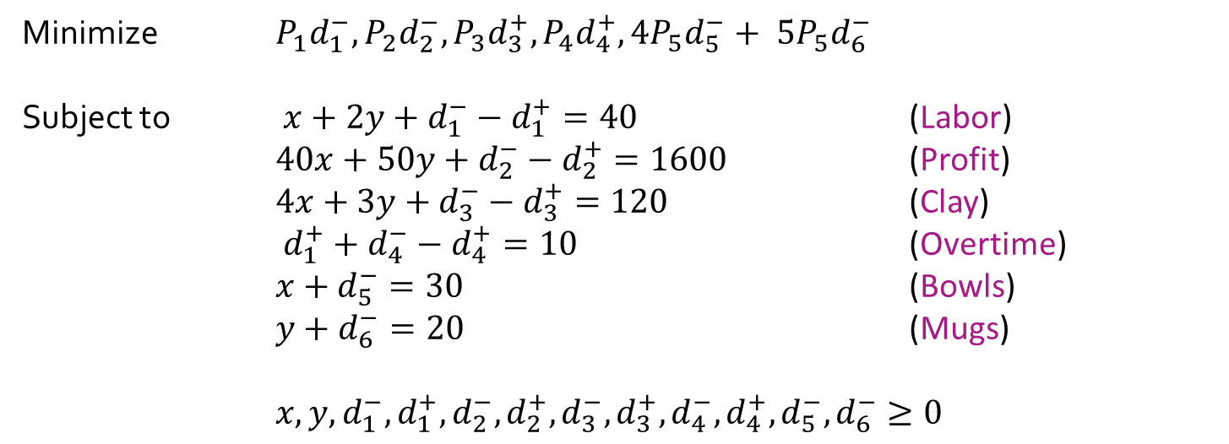
Ex: Beaver Creek Pottery
Full modified goal programming model
Minimize $P_{1}d_{1}^{−}, P_{2}d_{2}^{−}, P_{3}d_{3}^{+},P_{4}d_{4}^{+},{4P}_{5}d_{5}^{−}+ {5P}_{5}d_{6}^{−}$
Subject to $x+2y+d_{1}^{−}−d_{1}^{+}=40$ (Labor)
$40x+50y+d_{2}^{−}−d_{2}^{+}=1600$ (Profit)
$4x+3y+d_{3}^{−}−d_{3}^{+}=120$ (Clay)
$d_{1}^{+}+d_{4}^{−}−d_{4}^{+}=10$ (Overtime)
$x+d_{5}^{−}=30$ (Bowls)
$y+d_{6}^{−}=20$ (Mugs)
$x,y,d_{1}^{−},d_{1}^{+},d_{2}^{−},d_{2}^{+},d_{3}^{−},d_{3}^{+},d_{4}^{−},d_{4}^{+},d_{5}^{−},d_{6}^{−}≥0$

Slide 9
Ex: Oakdale School Busing
Oakdale County school board met in a special session
Federal Judge Barry ordered them to present an acceptable busing plan for racially balancing the 4 high schools in Oakdale County
Racial balance of the 4 high schools
West High School: 500 Black & 500 White
North High School: 300 Black & 1,000 White
East High School: 400 Black & 1,050 White
South High School: 800 Black & 450 White
Overall 5,000 Students: 40% Black & 60% White

Slide 10
Ex: Oakdale School Busing
Act I
“Rather than starting off by trying to shift students from one district to another, why don’t we try to establish what we want to accomplish?” – JC
“Good idea, Lil John” – FH
“Sixty percent of our students are white and 40% are black, so that’s what we need our schools to be, 60% and 40%.” – JC
“That’s okay for you to say, Lil John, because your district (East) is already close to those proportions. My district in the North is a long way from that ratio, and we would have to bus a lot of our students.” – BP
“I’m not saying it, Betty; Judge Barry has been saying it for 6 months.” – JC
“John’s right, Betty, and we’re not busing students yet; we’re just putting down our objectives. I think that must be our highest-priority.“ – FH
They all node in agreement like a bunch of bobbleheads
Intermission I

Slide 11
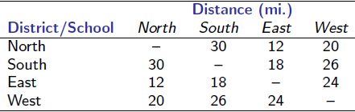
Ex: Oakdale School Busing
Act II
“Since we’re going to have to bus students to achieve this ratio at each school, I think we ought to try to minimize the amount of traveling.”– MG
Fred Harvey noted page 10 of their handout with a chart showing the average mileage a student in one district would have to travel by bus to the high school in each of the other districts

Slide 12
Ex: Oakdale School Busing
Act II
“Why not set reasonable objectives for total busing miles, for the students’ sake and for budgeting reasons? I would suggest about 30,000 miles per day, based on the miles we bus students now. If we get much higher than that we’re not going to have the money to pay for it, and it means we’ll be busing students all over the place.” – CW
They all node in agreement like a bunch of bobbleheads
“Okay, that’ll be our number two goal.” – FH
Intermission II

Slide 13
Ex: Oakdale School Busing
Act III
“I’ll tell you another thing I don’t want to see happen, and that’s more overcrowding at North High School. We have 100 students more than capacity now.” – BP
“You think you have problems! In East, we have 1,450 students and a capacity of 1,000. I think no overcrowding is a great idea!” – BW
“I agree. We’re 250 over our capacity at South High School” – MG
“That’s a nice idea, and I realize that we have 200 students less than our capacity at West High School. However, let’s face it, in the county we have capacity for 4,400, not 5,000, students, so there’s going to be some overcrowding. I think our objective should be that all 4 schools should share in the overcrowding proportionally.” – JC
“That sounds reasonable to me. How about the rest of you? Okay to say our number three goal is to be as close to capacity at each school as possible but share proportionally in the overcrowding”
They voice their approval by joining hands and singing

Slide 14
Ex: Oakdale School Busing
Act III
“Well, I think we have identified the things we want to accomplish in our plan. Now, if we could just use some magic trick to find for busing students between the districts that would achieve all these goals.” – JC
The others nodded and frowned because they don’t know math.
The End and Credits
John Connor Mario Giacomazzo
Fred Harvey Mario Giacomazzo
Betty Philips Mario Giacomazzo
Mickey Gibbony Mario Giacomazzo
Cassandra Watkins Mario Giacomazzo
Bob Wilson Mario Giacomazzo
Narration Mario Giacomazzo

Slide 15
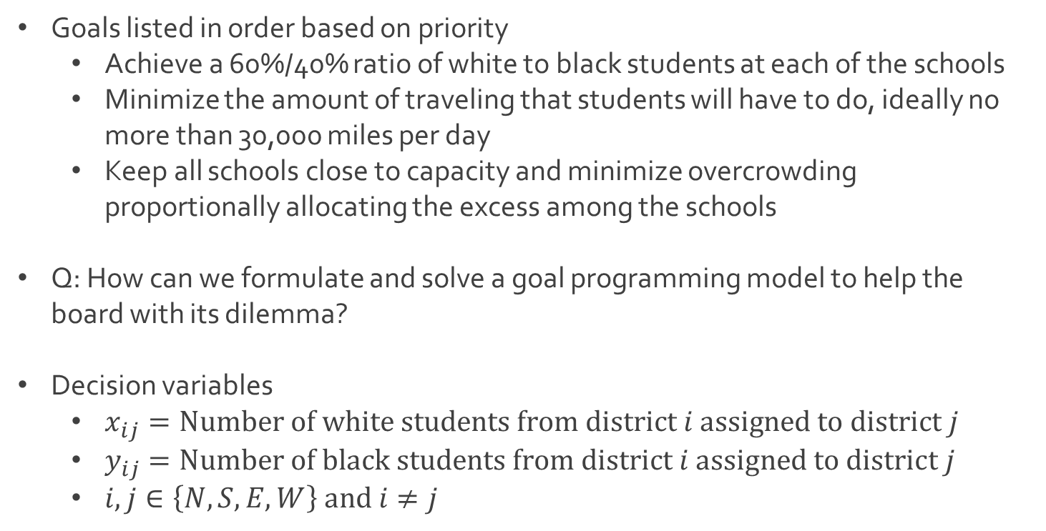
Ex: Oakdale School Busing
Goals listed in order based on priority
Achieve a 60%/40% ratio of white to black students at each of the schools
Minimize the amount of traveling that students will have to do, ideally no more than 30,000 miles per day
Keep all schools close to capacity and minimize overcrowding proportionally allocating the excess among the schools
Q: How can we formulate and solve a goal programming model to help the board with its dilemma?
Decision variables
$x_{ij}=Number of white students from district i assigned to district j$
$y_{ij}=Number of black students from district i assigned to district j$
$i,j∈\left\{N,S,E,W\right\} and i≠j$

Slide 16
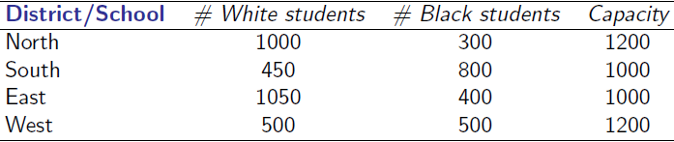
Ex: Oakdale School Busing
Helpful tables of key information
Current amounts of white and black students along with capacity
Distances each student travels between districts

Slide 17




The End
Dale

